Slide 1


Rachel Armstrong
22/05/2022

Slide 2

Outline
Executive Summary
Introduction
Methodology
Results
Conclusion

Slide 3
Executive Summary
Data was:
Extracted from SpaceX API or Wikipedia
Wrangled into a suitable format
Explored using:
Graphs
SQL queries
Interactive dashboards
Split into training and testing data
Created ML models using training data
Evaluated models using test data
Results:
All models performed equally well with 83% accuracy
Models have false positives but not false negatives
Limited size of dataset makes testing accurately difficult, and further data would give more confidence to results

Slide 4
Introduction
SpaceX offers rocket launches at a significantly lower cost than competitors
They are able to do this by re-using part of the rocket
They can only reuse the rocket part if this part lands successfully
If we can predict if a rocket part will land successfully then this can be used by competitors to identify cost savings

Slide 5

Section 1

Slide 6
Methodology
Executive Summary
Data collection methodology:
Data collected either via API or web scraping Wikipedia
Perform data wrangling
Outcomes categorized as successful or unsuccessful landings
Perform exploratory data analysis (EDA) using visualization and SQL
Perform interactive visual analytics using Folium and Plotly Dash
Perform predictive analysis using classification models
Built, tuned and evaluated classification models

Slide 7
Data Collection
Data was collected via two different methods:
Scraping the SpaceX Wikipedia website using BeautifulSoup
Requesting SpaceX data directly from the SpaceX API and merging the multiple requests

Slide 8

Data Collection – SpaceX API
Collect
Request data from SpaceX API
Clean
Reduce columns to only rocket, payloads, launchpad, cores, flight number and date
Merge
Merge data with API calls for
Read JSON into pandas CSV
Launch Site
Booster Version
Payload
Core
Filter
Exclude Falcon 1 data
Wrangle
Replace missing Payload Mass Data with mean of Payload Mass
Restrict to launches before 2020/11/14
Remove all rockets with multiple cores or payloads
Store
Save to CSV file
https://github.com/qwerty16/portfolio-data/blob/main/spacex/Data%20Collection%20API.ipynb

Slide 9
Data Collection - Scraping
Collect
Request HTML data from Falcon 9 Launches Wikipedia
Extract
Extract column names
Clean
Extract information from each cell
Process using BeautifulSoup and focus on the third table on the page
Parse
Combine column names and data into a pandas data frame
Store
Save to CSV file
Parse the data into a standard format
https://github.com/qwerty16/portfolio-data/blob/main/spacex/Data%20Collection%20with%20Web%20Scraping.ipynb

Slide 10
Data Wrangling
Extract Outcomes
Determined the unique values that the landing outcome column could have
Split Outcomes
Split the list of possible outcomes into successful and unsuccessful outcomes
Classify records
For each record determine if the landing outcome was successful or not
Store this in a new column ‘Class’
Store
Save to CSV file
https://github.com/qwerty16/portfolio-data/blob/main/spacex/Data%20Wrangling.ipynb

Slide 11
EDA with Data Visualization
Charts were plotted to identify trends and correlations between available features.
Charts plotted:
Flight number vs launch site
Payload vs launch site
Orbit type vs success rate
Flight number vs orbit type
Payload vs orbit type
Success rate over time
https://github.com/qwerty16/portfolio-data/blob/main/spacex/Data%20Exploration%20using%20Matplotlib.ipynb

Slide 12
EDA with SQL
Names of unique launch sites
Launch sites which begin with CCA
Mass of payload launched by NASA
Average payload carried by F9 v1.1 booster
First successful ground pad landing date
Successful boosters used in drone ship landings with payload mass between 4000 and 6000 kg
Count of launches aggregated by outcome
Booster versions which have carried maximum payload mass
Failed drone ship landings in 2015 with launch site and booster version details
Landing outcomes between 2010-06-04 and 2017-03-20, ranked in descending order
https://github.com/qwerty16/portfolio-data/blob/main/spacex/Data%20Exploration%20with%20SQL.ipynb

Slide 13
Build an Interactive Map with Folium
Circle added to each launch site labelled with the site name
Cluster of markers added to each site, one per launch, colour coded according to if the launch was successful or not
Added a line between a launch site and nearby points of interest
https://github.com/qwerty16/portfolio-data/blob/main/spacex/Data%20Visualisation%20with%20Folium.ipynb

Slide 14
Build a Dashboard with Plotly Dash
Pie chart which can show successes for each site or successes vs failures for one site (dropdown to select site)
Scatter chart showing successes vs payload mass, each point was colour coded according to its launch site. The launch site is also affected by the site dropdown. There is a slider filter which allows restriction of the range of payload masses which are included
https://github.com/qwerty16/portfolio-data/blob/main/spacex/spacex_dash_app.py

Slide 15
Predictive Analysis (Classification)
Import data
Scale
Transform using StandardScaler to normalise
Split
Tune
Import into a pandas dataframe
Split the data into training and test sets
For each model tune hyperparameters using GridSearchCV
Fit
Fit the model to the training data
Evaluate
Evaluate the accuracy of the model using the testing data
https://github.com/qwerty16/portfolio-data/blob/main/spacex/SpaceX_Machine%20Learning%20Predictions.ipynb

Slide 16
Results
Exploratory data analysis results
Interactive analytics demo in screenshots
Predictive analysis results

Slide 17

Section 2

Slide 18
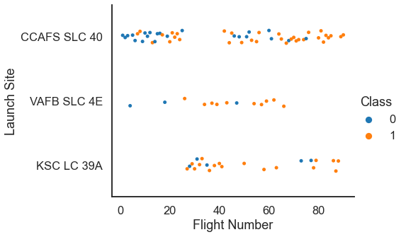
Flight Number vs. Launch Site

Slide 19
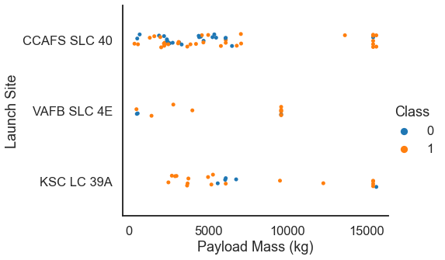
Payload vs. Launch Site

Slide 20
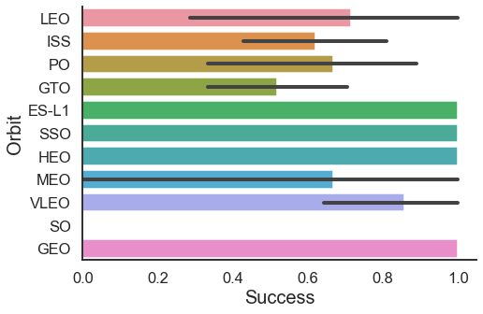
Success Rate vs. Orbit Type

Slide 21
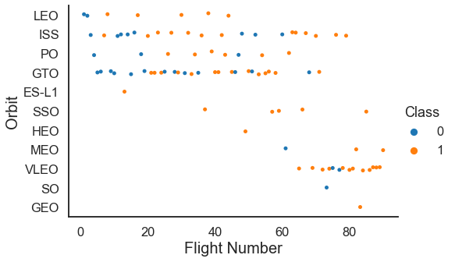
Flight Number vs. Orbit Type

Slide 22
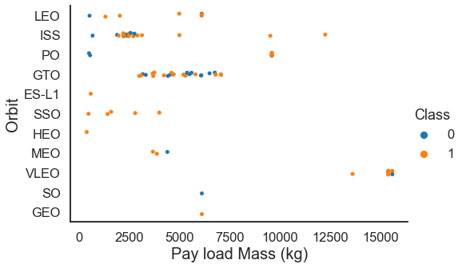
Payload vs. Orbit Type

Slide 23
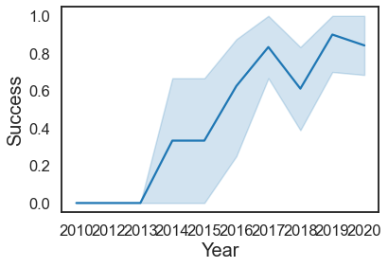
Launch Success Yearly Trend

Slide 24
All Launch Site Names
 | Launch Site
0 | CCAFS LC-40
1 | VAFB SLC-4E
2 | KSC LC-39A
3 | CCAFS SLC-40

Slide 25
Launch Site Names Begin with 'CCA'
 | Date | Time (UTC) | Booster Version | Launch Site | Payload | Payload Mass KG | Orbit | Customer | Mission Outcome | Landing Outcome
0 | 04-06-2010 | 18:45:00 | F9 v1.0 B0003 | CCAFS LC-40 | Dragon Spacecraft Qualification Unit | 0 | LEO | SpaceX | Success | Failure (parachute)
1 | 08-12-2010 | 15:43:00 | F9 v1.0 B0004 | CCAFS LC-40 | Dragon demo flight C1, two CubeSats, barrel of... | 0 | LEO (ISS) | NASA (COTS) NRO | Success | Failure (parachute)
2 | 22-05-2012 | 07:44:00 | F9 v1.0 B0005 | CCAFS LC-40 | Dragon demo flight C2 | 525 | LEO (ISS) | NASA (COTS) | Success | No attempt
3 | 08-10-2012 | 00:35:00 | F9 v1.0 B0006 | CCAFS LC-40 | SpaceX CRS-1 | 500 | LEO (ISS) | NASA (CRS) | Success | No attempt
4 | 01-03-2013 | 15:10:00 | F9 v1.0 B0007 | CCAFS LC-40 | SpaceX CRS-2 | 677 | LEO (ISS) | NASA (CRS) | Success | No attempt

Slide 26
Total Payload Mass
SELECT sum(Payload_Mass_KG) as Total FROM spacex WHERE Customer = 'NASA (CRS)
 | Total
0 | 45596.0

Slide 27
Average Payload Mass by F9 v1.1
select avg(Payload_Mass_KG) as Average from spacex where Booster_Version like 'F9 v1.1%%’
 | Average
0 | 2534.6667

Slide 28
First Successful Ground Landing Date
select min(Date) as First_Date from spacex where Landing_Outcome = 'Success (ground pad)’
 | First_Date
0 | 01-05-2017

Slide 29
Successful Drone Ship Landing with Payload between 4000 and 6000
 | Booster_Version
0 | F9 FT B1022
1 | F9 FT B1026
2 | F9 FT B1021.2
3 | F9 FT B1031.2

Slide 30
Total Number of Successful and Failure Mission Outcomes
 | Outcome | Count
0 | Success | 98
1 | Failure (in flight) | 1
2 | Success (payload status unclear) | 1
3 | Success | 1

Slide 31
Boosters Carried Maximum Payload
 | Booster Version
0 | F9 B5 B1048.4
1 | F9 B5 B1049.4
2 | F9 B5 B1051.3
3 | F9 B5 B1056.4
4 | F9 B5 B1048.5
5 | F9 B5 B1051.4
6 | F9 B5 B1049.5
7 | F9 B5 B1060.2
8 | F9 B5 B1058.3
9 | F9 B5 B1051.6
10 | F9 B5 B1060.3
11 | F9 B5 B1049.7

Slide 32
2015 Launch Records
 | Date | Booster_Version | Launch_Site
0 | 2015-01-10 | F9 v1.1 B1012 | CCAFS LC-40
1 | 2015-04-14 | F9 v1.1 B1015 | CCAFS LC-40

Slide 33
Rank Landing Outcomes Between 2010-06-04 and 2017-03-20
 | Outcome | Count
0 | No attempt | 10
1 | Failure (drone ship) | 5
2 | Success (drone ship) | 5
3 | Controlled (ocean) | 3
4 | Success (ground pad) | 3
5 | Failure (parachute) | 2
6 | Uncontrolled (ocean) | 2
7 | Precluded (drone ship) | 1

Slide 34

Section 3

Slide 35
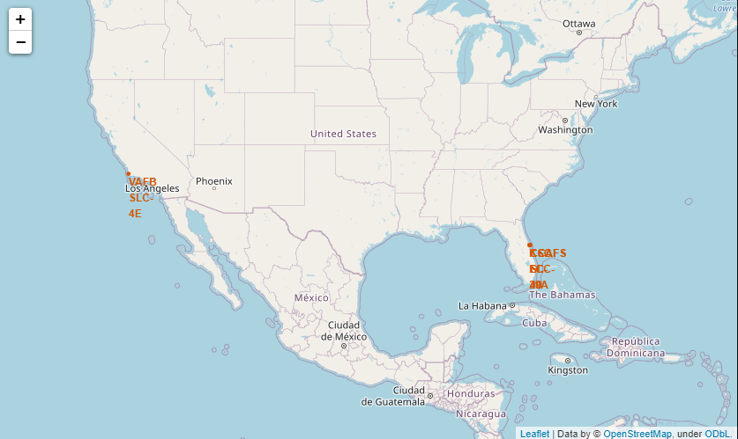
Launch Sites

Slide 36
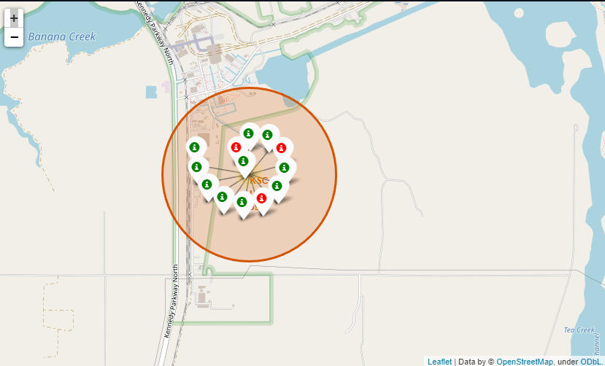
Successes/Failures per launch site

Slide 37
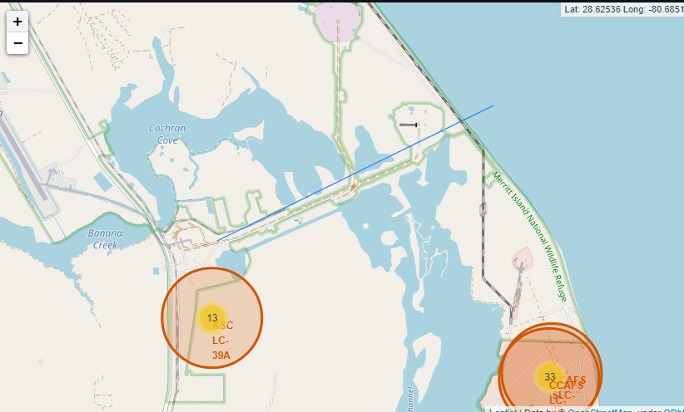
Distance of launch site to coast

Slide 38

Section 4

Slide 39
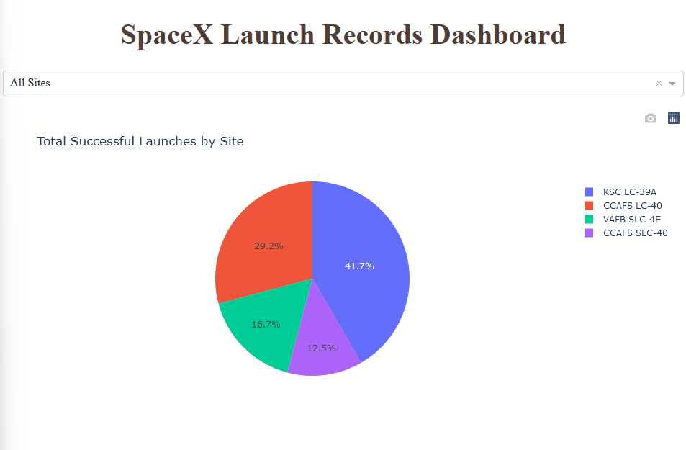
Total Successful Launches by Site

Slide 40
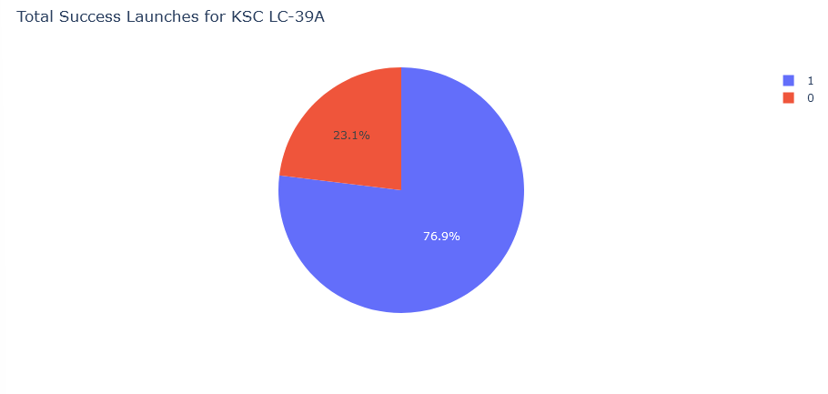
Ratio of successful launches for KSC LC-39A

Slide 41
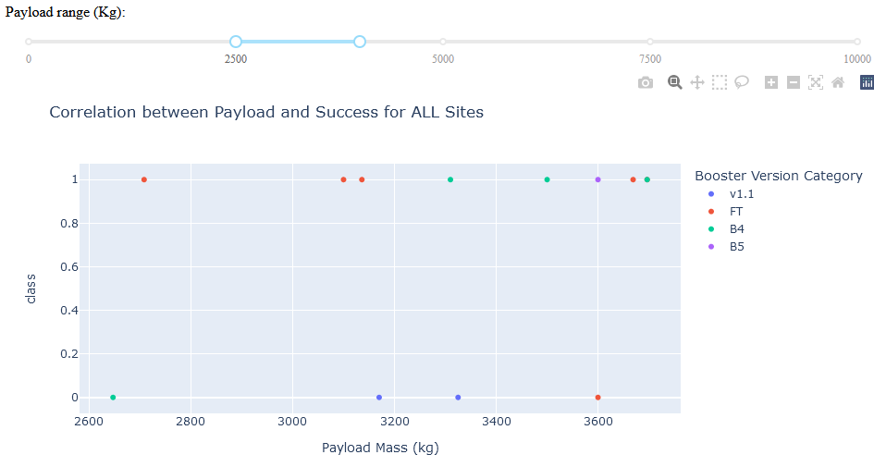
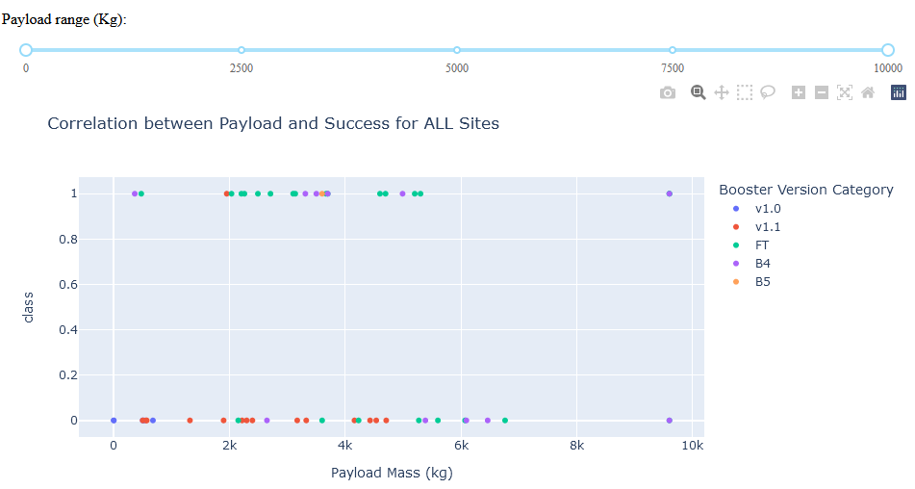
Scatter chart of Payload Mass Vs Success

Slide 42

Section 5

Slide 43
Classification Accuracy

Slide 44
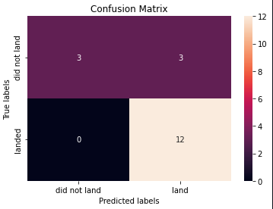
Confusion Matrix
Our model correctly predicted 12 successful landings and 3 unsuccessful landings
3 unsuccessful landings were incorrectly predicted to be successful by our model (false positives)
No landings that were successful were incorrectly predicted to be unsuccessful (false negatives)

Slide 45
Conclusions
Data about the SpaceX launches can be scraped from Wikipedia or their API
All models created from this data had the same overall accuracy
Our models have false positives but not false negatives, therefore it can be used to predict if a stage will fail land
The lack of overall data points limit the possibilities for testing the model

Slide 46


